Slide 1
Test Driven Development
Code Better, Sleep better

Slide 2
Yet most C++ systems exhibit the same problems we all see time and time again, usually regardless of language.
Monstrous source files with thousands of lines
Member functions with hundreds or thousands of lines of inscrutable code
Volumes of dead code
Build times extending into several hours
High numbers of defects
Logic too convoluted by quick fixes to be safely managed
Code duplicated across files, classes, and modules
Code riddled with long-obsolete coding practices

Slide 3
The effort required to add new functionality on such large, long-lived C++systems usually disappoints and often is inestimable.
Simply understanding a passage of code in order to change a few lines of code can take hours, even days.
Productivity is further drained as developers wait hours to determine whether their changes compiled and wait even longer to see whether they integrated well with the remainder of the system.

Slide 4
Is this decay inevitable?
No! Test-Driven Development is a tool you can master and wield in order to help stave off system entropy.

Slide 5
Test Driven Development
It doesn’t have to be this way. Test-Driven Development (TDD), a software design technique devised in the late 1990s, can help you wrestle your C++ system to the ground and keep it under control as you continue adding new features.

Slide 6
The primary intent for this lesson is to teach you a disciplined approach for the practical application of TDD. You’ll learn the following:
The fundamental mechanics of TDD
The potential benefits of TDD
How TDD helps you address design deficiencies as they arise
The challenges and costs of doing TDD
How TDD can reduce or even eliminate debugging sessions
How to sustain TDD over time

Slide 7
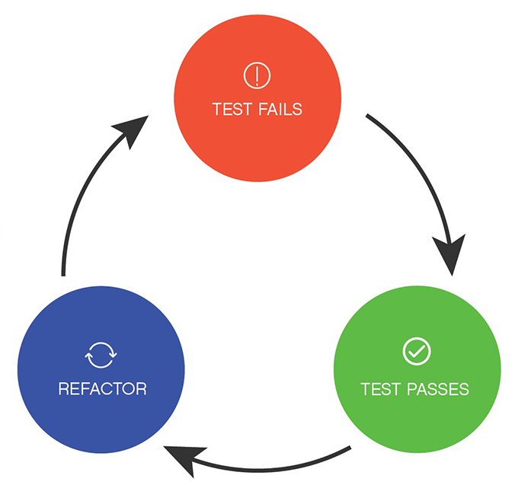
TDD Cycle
Write a test,
Get it to pass,
Clean up the design.

Slide 8
First Example
Searching is a common need in many applications. An effective search should find matches even if the user misspells words.
In this lesson, we will test-drive a Soundex class that can improve the search capability in an application.
The long-standing Soundex algorithm encodes words into a letter plus three digits, mapping similarly sounding words to the same encoding.

Slide 9
Soundex Algorithm
Retain the first letter. Drop all other occurrences of a, e, i, o, u, y, h, w
Replace consonants with digits (after the first letter):
b, f, p, v: 1
c, g, j, k, q, s, x, z: 2
d, t : 3
l: 4
m, n: 5
r: 6
If two adjacent letters encode to the same number, encode them instead as a single number. Also, do so if two letters with the same number are separated by h or w (but code them twice if separated by a vowel). This rule also applies to the first letter.
Stop when you have a letter and three digits. Zero-pad if needed.

Slide 10
A common misconception of TDD
A common misconception of TDD is that you first define all the tests before building an implementation. Instead, you focus on one test at a time and incrementally consider the next behavior to drive into the system from there.

